Slide 1


City of London Green futures Challenge
In partnership with the City of London Youth Natural Environment Board

Slide 2
What is the Green Futures Challenge?
A competition that promotes sustainable activities in your community
Presents an opportunity for you to speak up, step up, and take action.
Provides support so you can design and deliver real entrepreneurial solutions in your community
At the Youth Natural Environment Board, we believe it’s our generation that will finally stop talking and start leading the change. Together we will epitomise the infamous phrase “less talk and more action!”

Slide 3
What’s in it for you?
Create real change: We challenge you to design and deliver a real-life entrepreneurial solution to an environmental challenge in your community.
Freedom to innovate: You choose the issue, you shape the solution, whether it’s fashion, transport, tech, politics, finance, or food.
Industry mentorship: Get expert mentorship, from companies like EON.
Career opportunities: Explore exciting career opportunities with industry professionals, whilst shaping the future of the green economy.
Free green skills training: Gain real world skills at the brand new City of London Green Skills Hub; no complex jargon, no barriers, just opportunity.
Bring your ideas to life: Winners will be presented at the Merchant Taylors’ Hall and gain access to a fully funded incubator to turn their idea into reality.
Green thinking touches every industry. We at the YNEB challenge you to find one where it doesn’t!

Slide 4
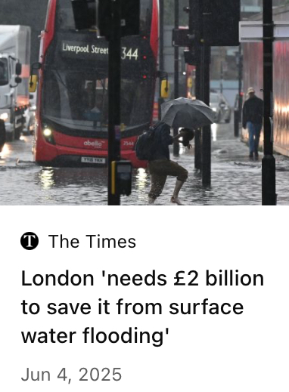
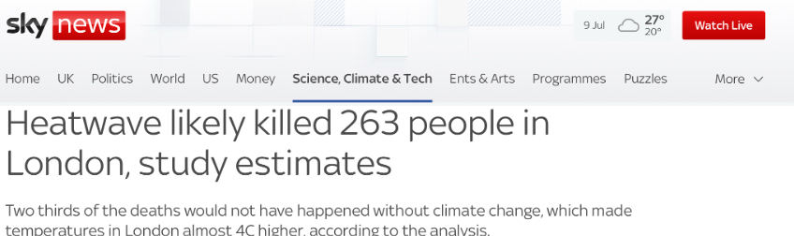
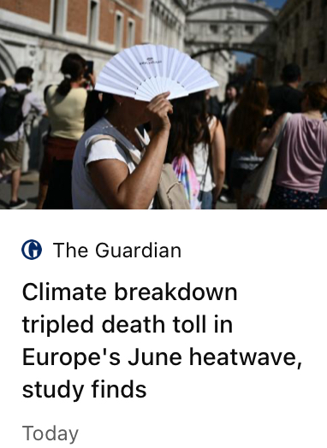
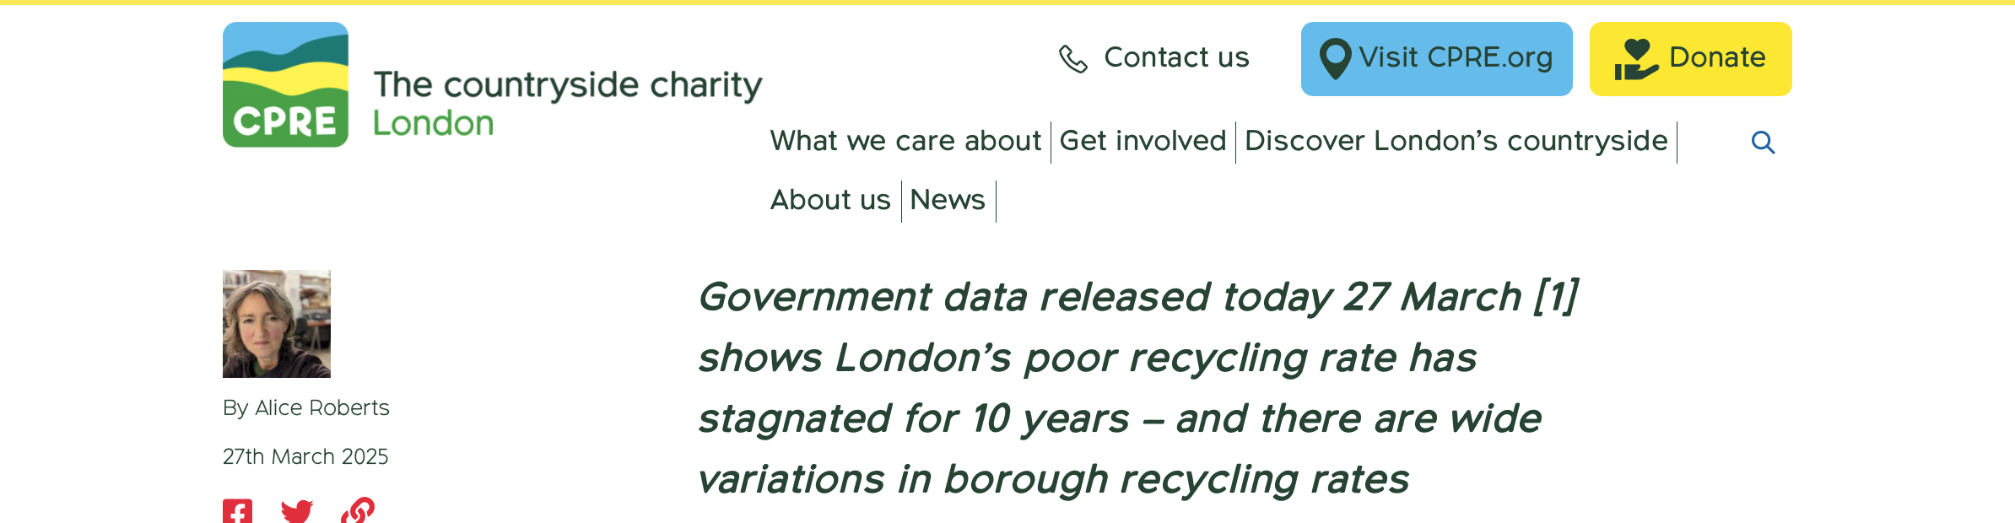
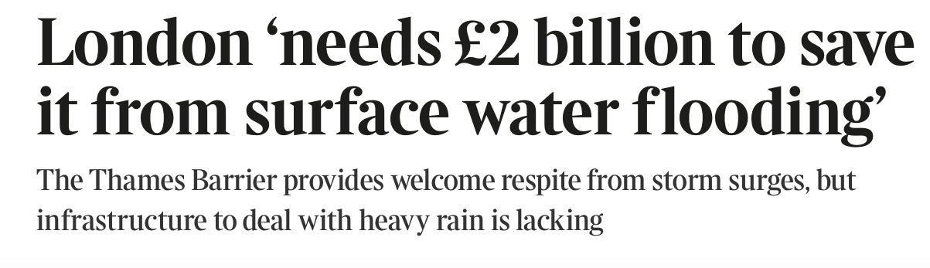
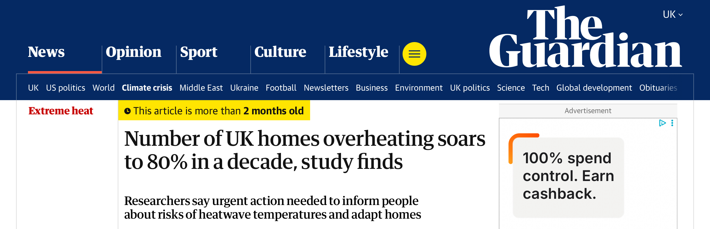
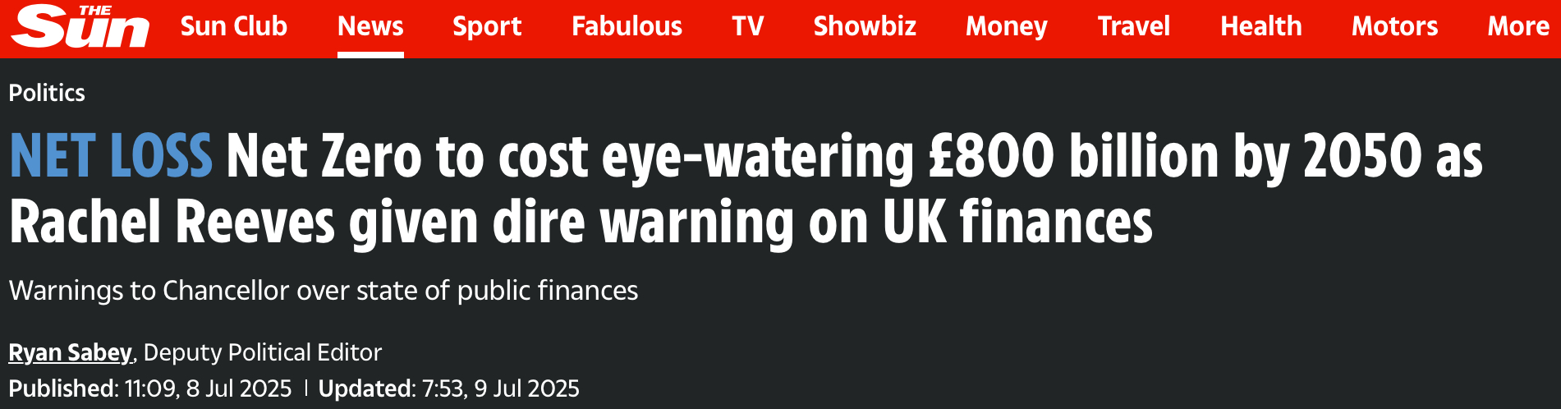
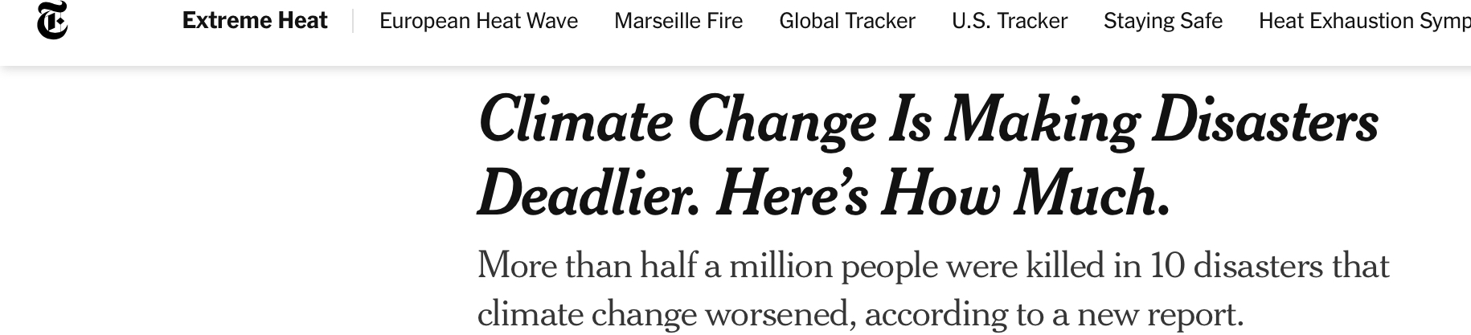
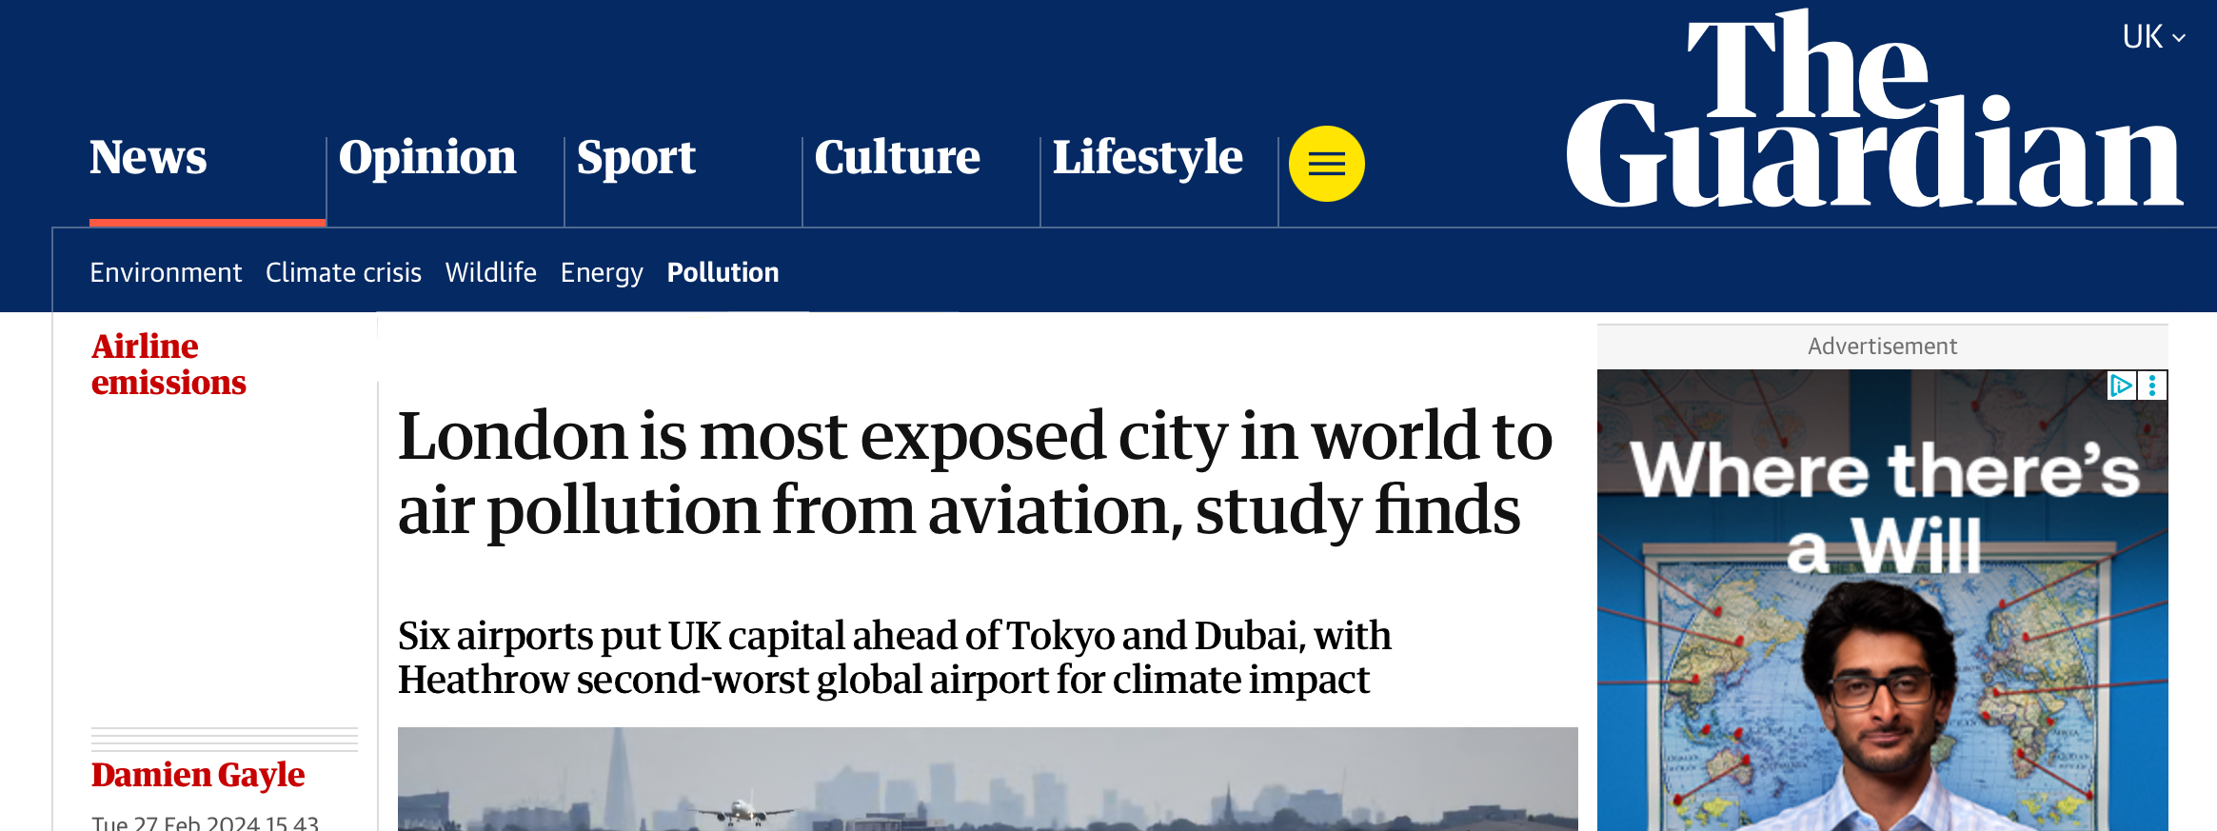
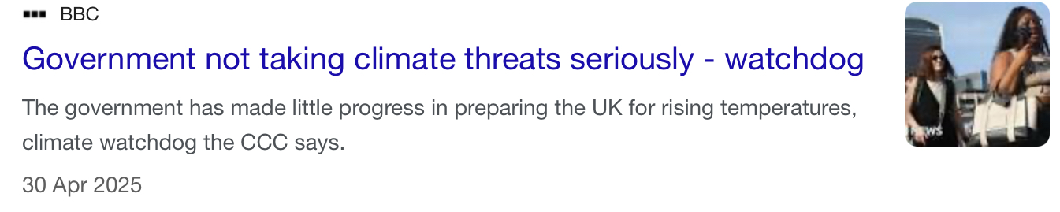
London urgently needs you!
It’s heating up. London is up to 10 degrees hotter than surrounding areas during heat waves due to the lack of vegetation (ClimateLondon.org.uk).
It’s sinking in waste. London produces near 7 billion tonnes of waste per year this is enough waste to fill Wembley Stadium around 9 times, and only a fraction is recycled (London.Gov.UK).
It’s hard to breath. Air pollution causes up to 4000 premature deaths each year in London, approximately 1 death every 2hrs is directly linked to air pollution (London.Gov.UK).

Slide 5
Time line of the competition:
Week 4:
Propose and submit your initial ideas:
- Gain feedback on their feasibility.
Final:
Teams present their idea. Winners are announced at Merchant Taylors’ Hall with many prizes up for grabs.
Week 1:
Launch at the brand-new City of London Green Skills Hub:
Meet like-minded individuals and explore environmentally focused careers.
Form teams of 3-6 students within your community.
Begin drafting innovative environmentally focused ideas.
Weeks 5&6:
Enter a virtual incubator, finalise your idea:
Receive structured mentorship and workshops targeting your idea.
Produce a presentation outlining your idea ready for the final.
Winners’ idea brought to life!
Weeks 2&3:
Receive virtual Green skills training:
Delivered by industry experts.
Equips you with necessary skills to realise the true potential of your ideas.

Slide 6
So what issues could you tackle?
Improve air pollution in your local area, particularly around schools.
Generate a green economy in your local area.
Improve food and general waste in your local area.
Change where the products you consume come from; ensure locally sourced produce and reduce fast fashion.
Introduce more green space and biodiversity on a budget.
Reduce water pollution and shortage in the ever hotter summers.
Create greener transport opportunities and congestion in your local area.
Challenge climate and social inequality, with the most vulnerable in society often being the worst affected.

Slide 7
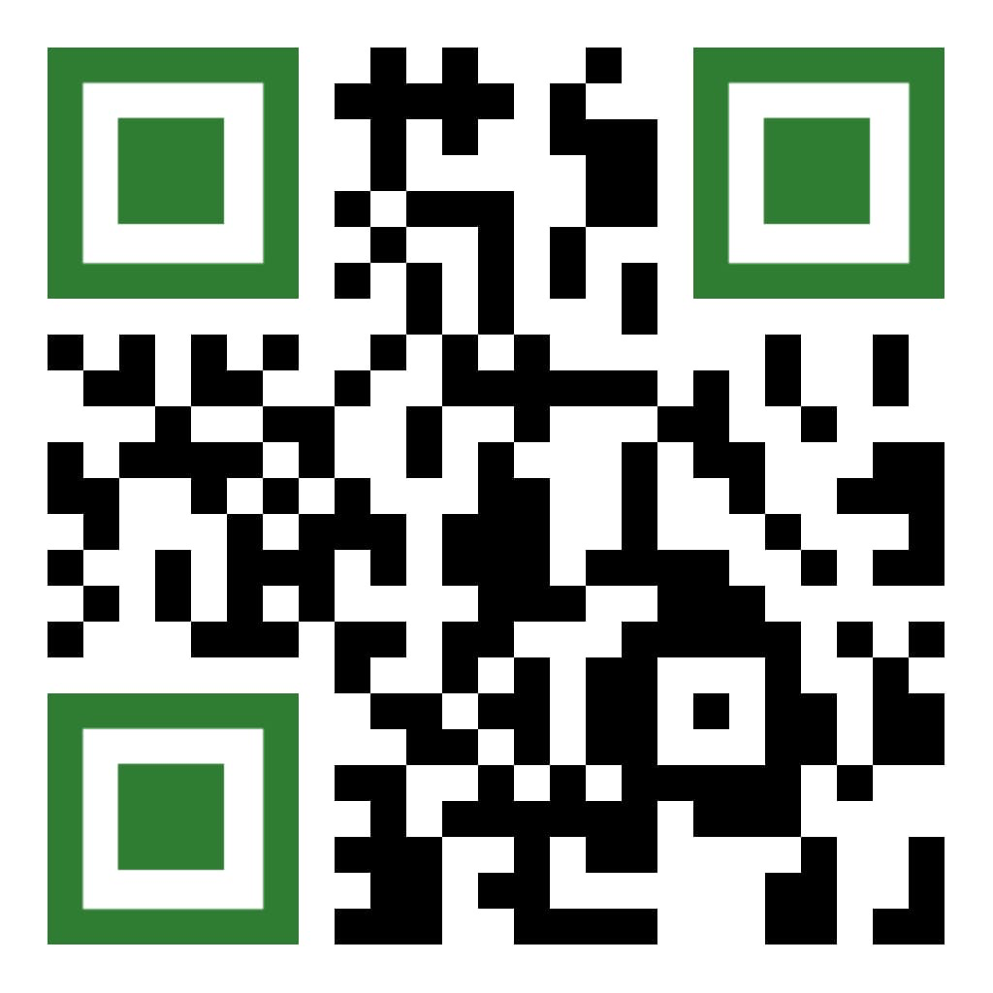
This isn’t just a school project, it’s your chance to lead real change, gain future-proof skills, and create a greener environment where you live
So what are you waiting for scan the QR code below and become part of the change:

